Slide 1
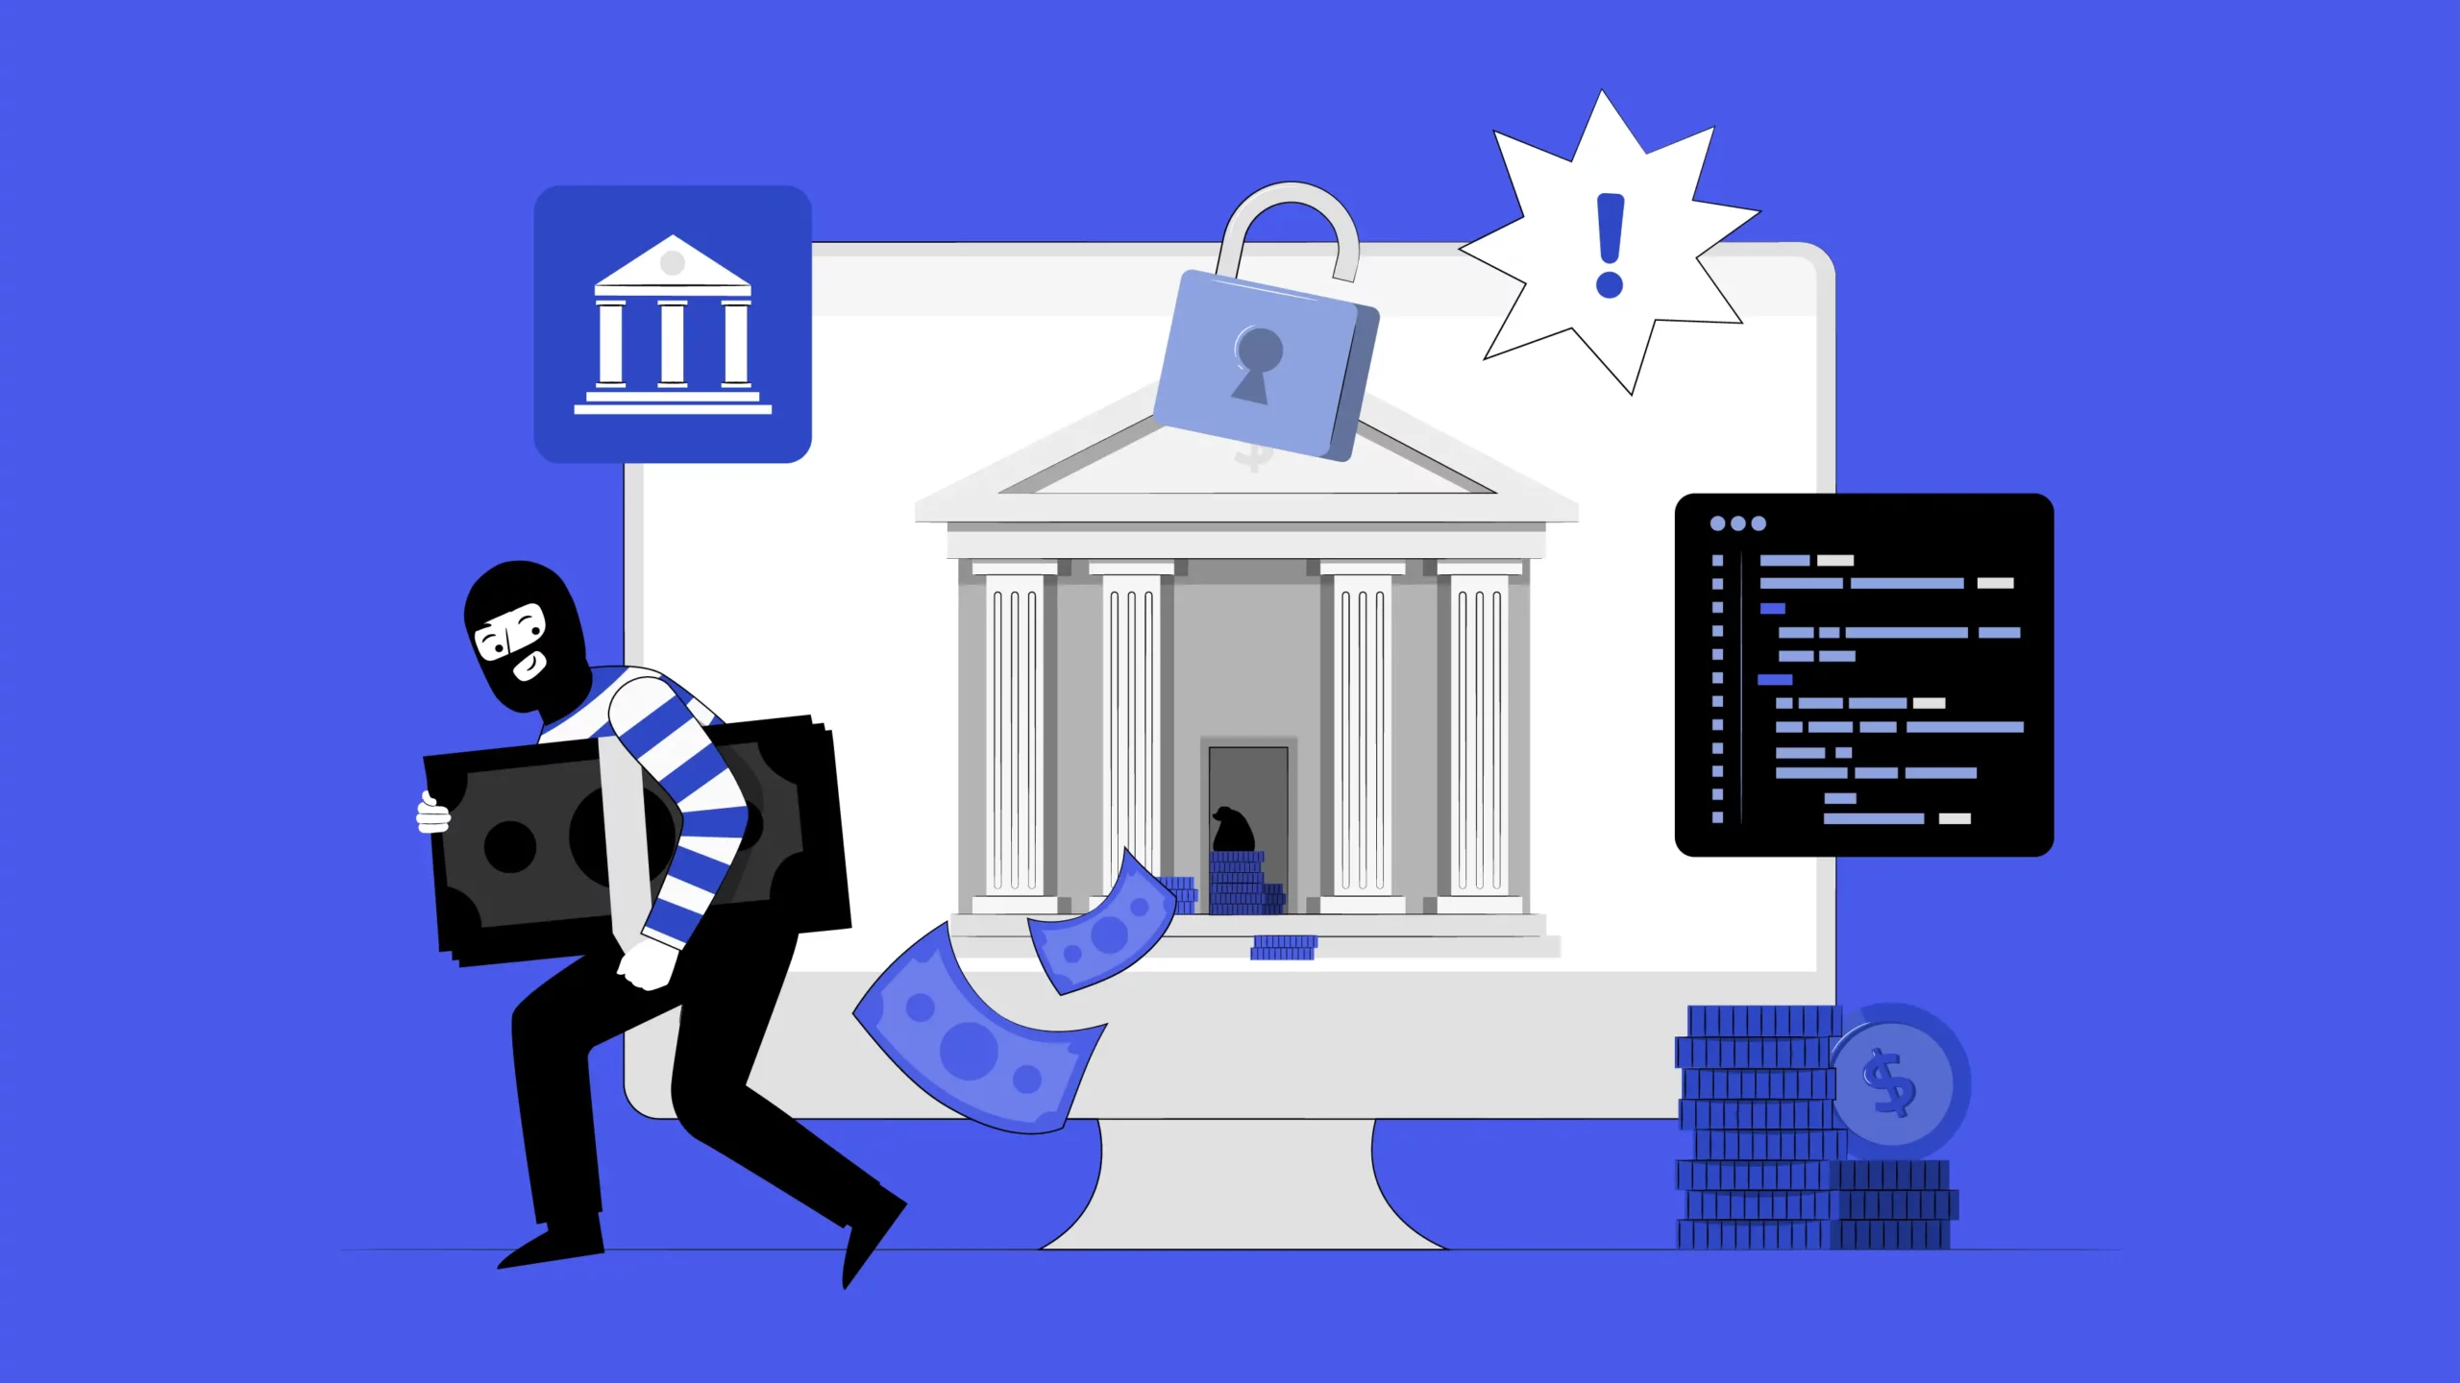
Fraud Detection and Prediction System for Financial Transactions
Supervised by:
Prof: Hala Abbas
Presented by:
Name: Mostafa Hussein

Slide 2
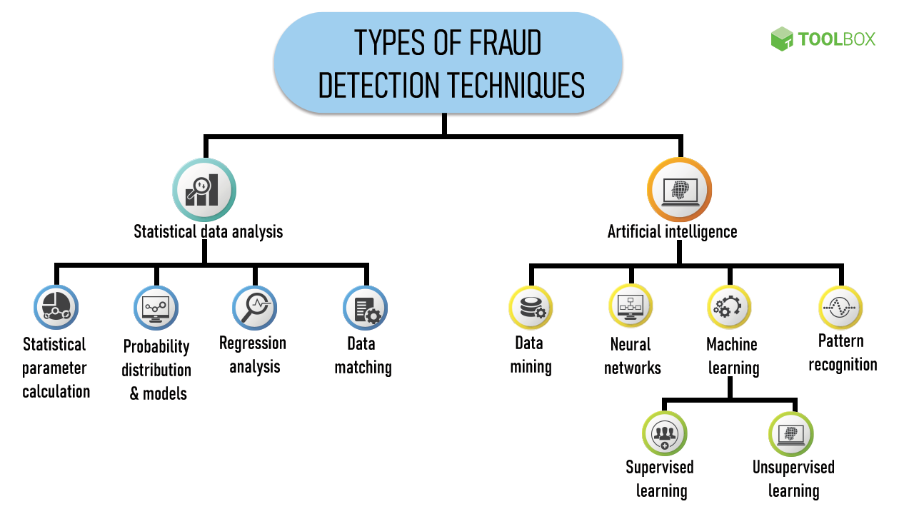
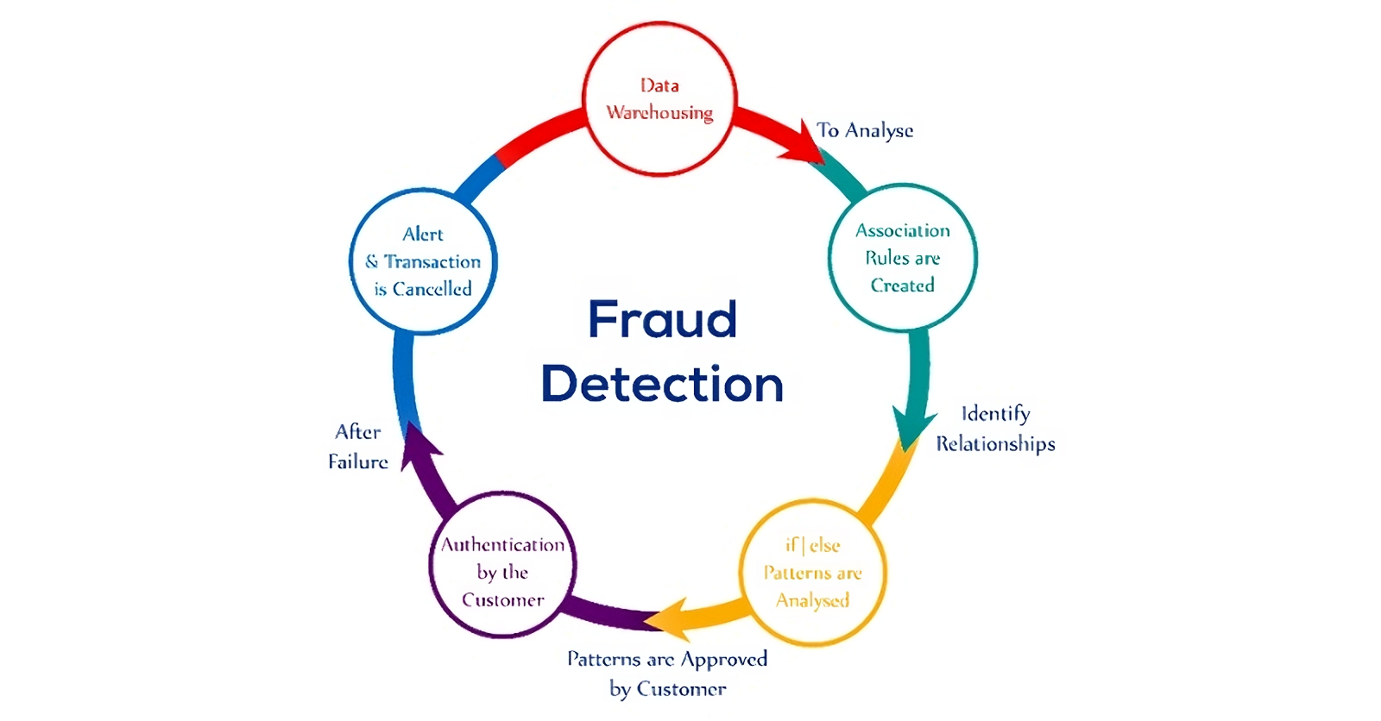
Agenda
Project Objectives
Suggested Solution & Deliverables
Project Requirements
Conclusion & Future Work
UML Diagrams
Problem & Motivation
Project Results
Graduation Project
part two

Slide 3
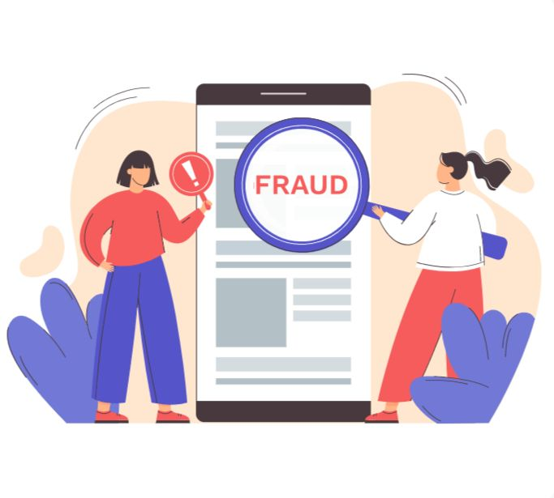
Problem & Motivation
Financial fraud is no longer just a risk, it's a growing global threat.
From silent digital thefts to large-scale scams, fraudulent transactions can drain accounts in seconds.
For banks and customers alike, this means loss of trust, massive financial damage, and in worst cases… bankruptcy.
Traditional systems fail to adapt — but fraud never sleeps.
Graduation Project
part Two

Slide 4
Project Objectives
Develop an AI-powered system capable of detecting and predicting fraudulent financial transactions in real-time.
Leverage machine learning models to improve detection accuracy and reduce false positives.
Create a user-friendly web interface for visualizing flagged transactions.
Ensure compliance with local banking regulations (e.g., Central Bank of Egypt guidelines).
Graduation Project
part Two

Slide 5
Suggested Solution & Deliverables
We propose an AI-based fraud detection system to identify suspicious activities.
The solution involves:
Preprocessing transaction data to handle imbalance and extract key features.
Training efficient models for high fraud detection accuracy.
Create a lightweight web application for real-time predictions and alerts.
Ensuring the system aligns with compliance standards like CBE regulations.
Graduation Project
part Two

Slide 6
Project Requirements
Kaggle – Dataset source
Jupyter Notebook – Development
Python and Libraries – Model development
Flask – Backend API
HTML – Web interface

Slide 7
Conclusion & Future Work
An AI-based fraud detection system was developed using machine learning to classify financial transactions as fraudulent or legitimate through a web-based application.
Future work includes improving model performance and enabling real-time fraud detection.

Slide 8
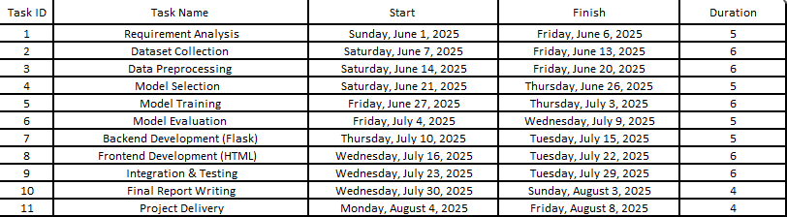
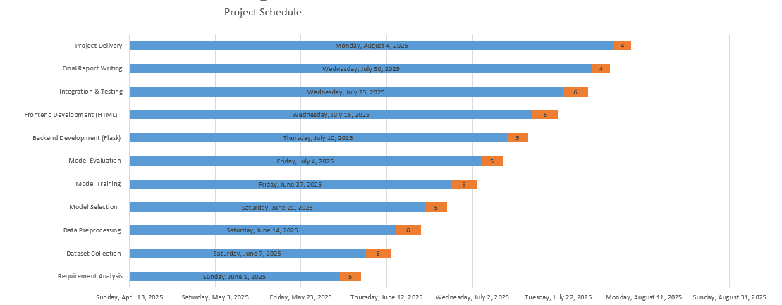
Gantt Chart

Slide 9
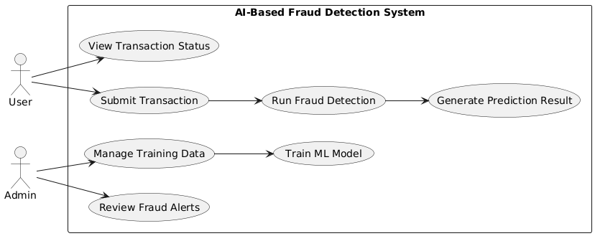
Use Case Diagram

Slide 10
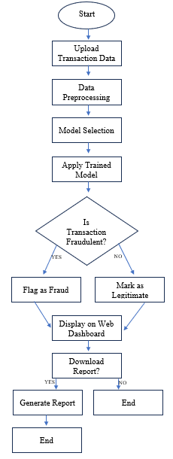
Flowchart

Slide 11
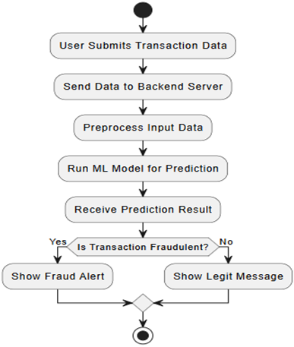
Activity Diagram

Slide 12
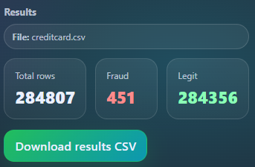
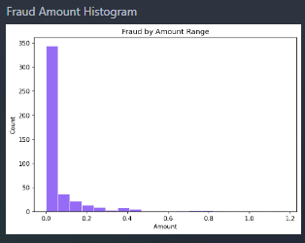
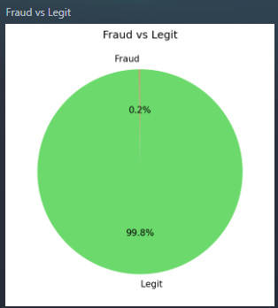
Project Results

Slide 13

Thank You!
Mostafa Hussein

